Slide 1
Graph Representation Learning with Random Walk Diffusions
Abdulkadir Çelikkanat
CentraleSupélec, Université Paris-Saclay
Ph.D. Thesis Defense
21 April 2021
Advisors: Nikos Paragios and Fragkiskos Malliaros

Slide 2
Outline
Introduction
TNE: Topic-Aware Latent Models for Representation Learning
EFGE: Exponential Family Graph Embeddings
Multiple Kernel Representation Learning on Graphs
Random Walk Diffusion meets Hashing for Scalable Graph Embeddings
Conclusion
Notes:
Firstly, I will introduce the GRL topic in general and then I will talk about our four contributions in the subsequent sections and in the last part I will conclude presentation with possible future works.

Slide 3
1. Introduction

Slide 4
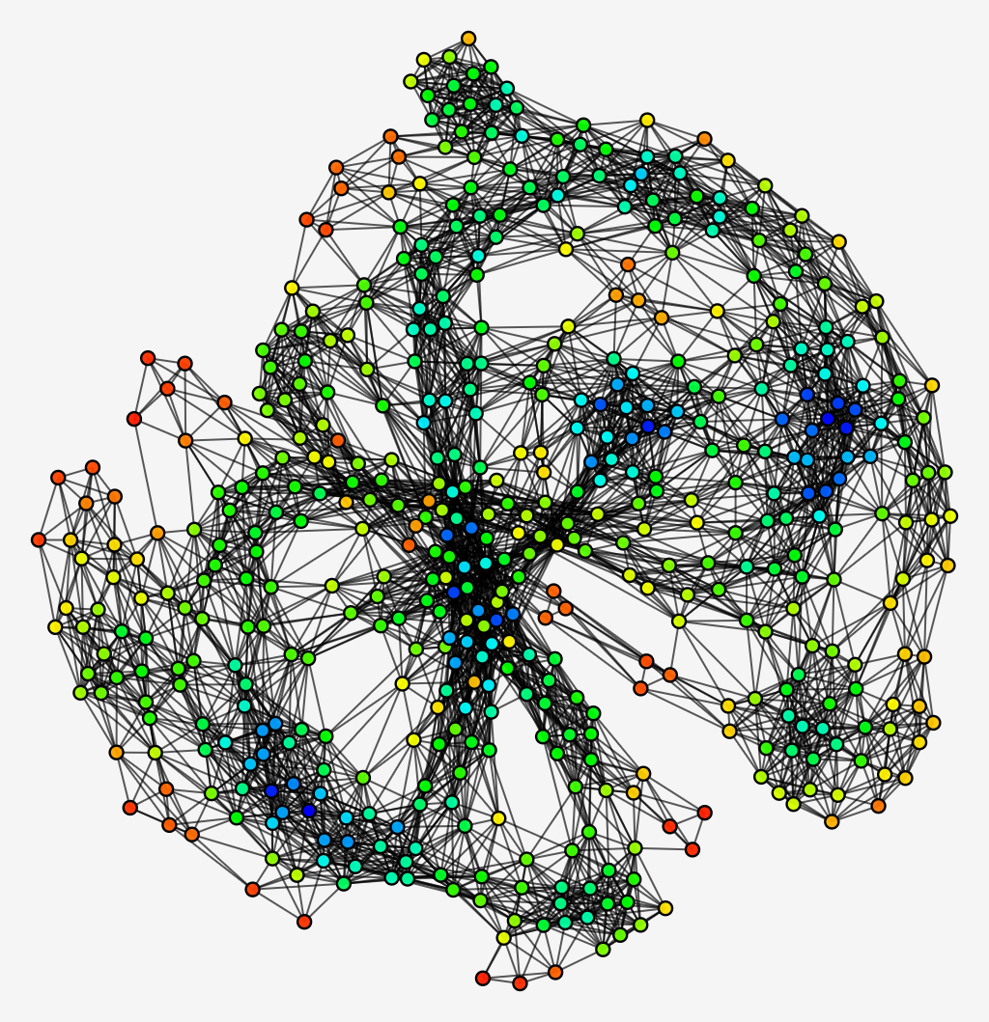
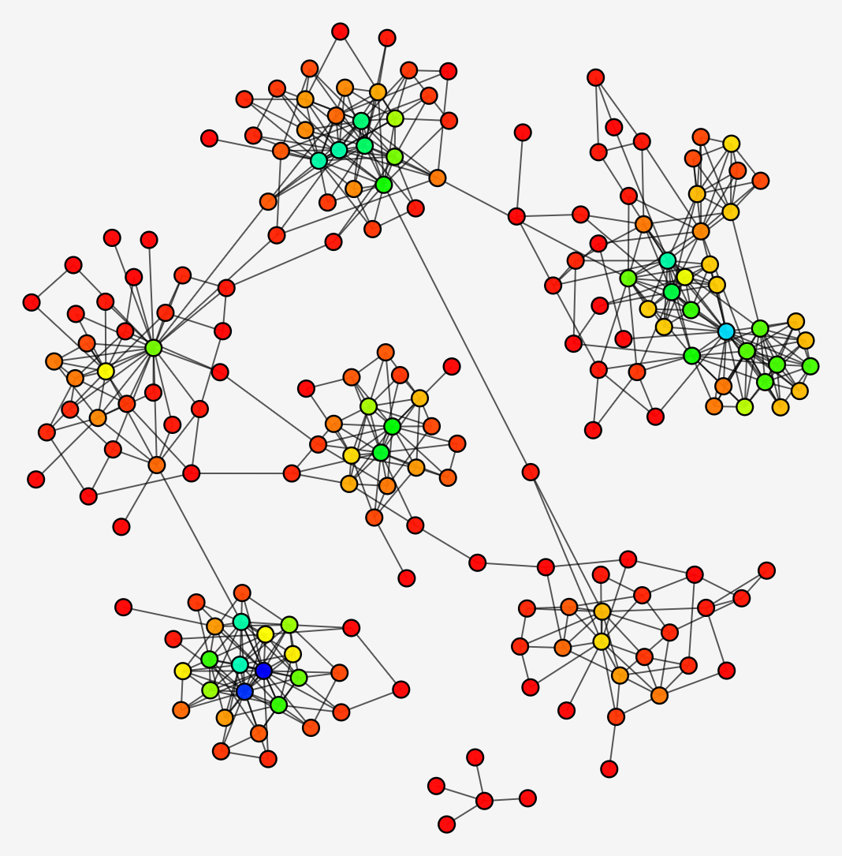
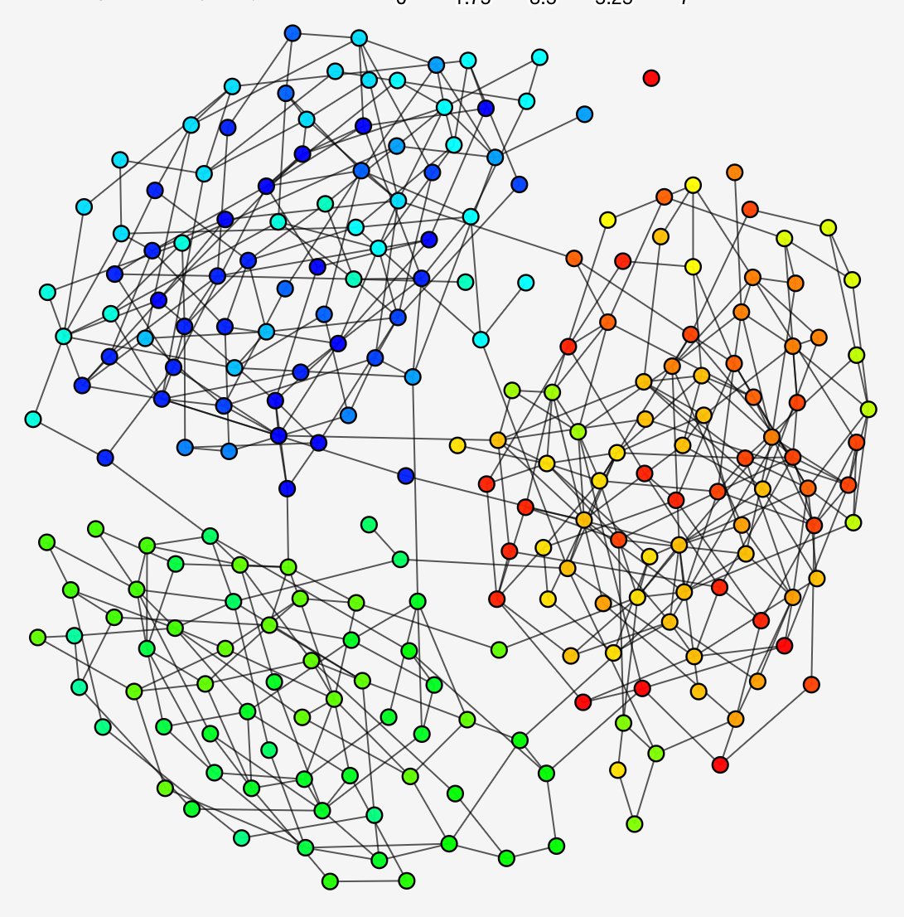
Graphs are everywhere
Graphs are everywhere
Protein-protein interaction networks
Friendship networks
Collaboration networks
Protein-protein interaction network
Friendship network
Collaboration network
[Rossi et al. AAAI ‘15]
Notes:
1. Graphs naturally emerge in many disciplines from physics, to biology, to social sciences with examples such as protein-proten networks, friendship networks and collaboration networks.
For example, in the colloboration network, the nodes indicate the author, there is an edge between a pair of nodes f they have a common work.

Slide 5
Traditional machine learning techniques on graphs
Network analysis tasks
Node classification
Link prediction
Clustering
Traditional techniques require hand-crafted features
Careful design of feature vectors concerning the task of interest
Features are limited to the specific downstream tasks and networks
Requires extensive computational cost
Notes:
2. Graph analysis is important to gain insights into the network’s hidden patterns and perform various predictive tasks. For example, one might wish to estimate the protein function in a biological network, recommend new products to a customer, and find a community of people sharing the same particular hobby in a social network.
1- Traditional MACHINE LEARNING techniques aim to carefully design feature vectors concerning the task of interest by choosing essential graph measures, such as clustering coefficient and core number.
2- Although these graph measures provide information about the various properties of a node, they are unable to capture the underlying pattern of the network.
2- Such features are often limited to specific networks or downstream tasks and they might require high space and computational cost.
3-Therefore, classical machine learning techniques on graphs relying on handcrafted features are not effective in practice.
4- The research community have inclined to alternative learnable approaches which can these features or representations automatically. So the GRL topic has attracted great interest in recent year.

Slide 6
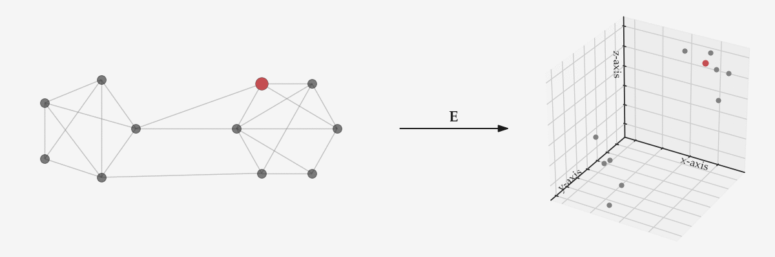
Graph Representation Learning
Notes:
- Roughly, GRL methods aim to map every node of a given network into a lower dimensional space by preserving some properties of interest.
- For example, we have two clusters in this figure and we map the nodes of the same clusters to the close representations.

Slide 7
Graph Representation Learning
[Hamilton, ’20]
Error/Loss function
Correct pairwise proximities
Metric of the embedding space
Node representations
Notes:
More formally, we we would like to obtain embeddings of nodes v and u in such a way that the distance in the embedding space between them should be close the user-specified proximities.
Here, l indicates the user defined loss function, d_x inidicate the metric embedding space and s_g is the correct pairwise proximities
So we learn the embeddings E of node v by optimizing this loss function defined by the user.
There exit many ways to define these proximities or similarities between the nodes.

Slide 8
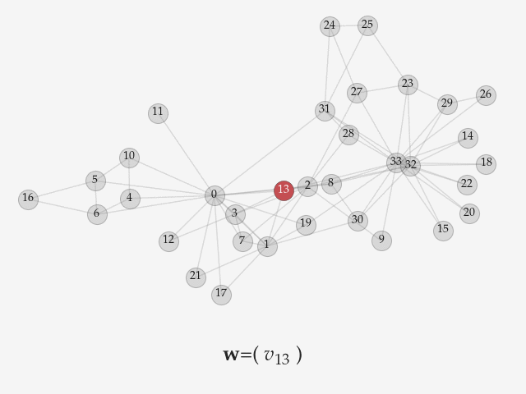
Construction of context sets with random walks
Two nodes should have close representations if they
Share common neighbors
Have the same structural roles
Share similar contexts
Random walks are a way of defining the context set of nodes
Flexible
Computationally efficient
Notes:
For ex, we might want to have close representations for a pair of nodes if they share many common neighbors, have the same structural roles in the network or if they share similar context.
Random walks are used for defining the context set of nodes.
- A random walk is basically a node sequence. It is generated by starting from an initial node and then we follow a neighbor by following a strategy.
They are flexible, we can choose a different random walk strategy such as uniform or biased.
They are computationally more efficient

Slide 9
Context Sampling: Generation of random walks
For a walk
Notes:
The RW-based GRL models generate a set of fixed-length random walks over the networks.
Then for each node in the walk,

Slide 10
Context Sampling: Generation of random walks
For a walk
Notes:
we define a window

Slide 11
Context Sampling: Generation of random walks
For a walk
Number of walks
Walk length
Window size
Notes:
+ The surrounding nodes around the center construct context set of the center node.
+ Then we learn representation by maximizing the co-occurrence probabilities of center and context nodes by inspiring from SkipGram.

Slide 12
Context Sampling: Generation of random walks
For a walk
Node representations
[Perozzi et al. KDD ‘14]
Number of walks
Walk length
Window size
Notes:
- General choice for the probability measure is softmax function, we learn the embeddings A and B.
For each node, we obtain two representations A and B,
and B represent the embedding when the node is considered as the center and A is the other way around.
Now we will propose 4 models leveraging the power of random walks.
Although these approaches are quite effective, n this thesis we aim to propose models alleviating the limitations of this approach as well as we examine other ways to leverage random walk for graph representation learning

Slide 13
Our contributions
Integration of Topological Features
with a focus on community structure [ÇM18; ÇM21]
Scalability
with diffusions & random projections [ÇPM21]
Modeling Node Interactions
with Exponential Family distributions [ÇM19b; ÇM20]
Kernelized Matrix Factorization
with random walks [ÇM19a; ÇSM21]
Notes:
How to incorporate the community structure of networks in learning node representations?

Slide 14
Our contributions
Integration of Topological Features
with a focus on community structure [ÇM18; ÇM21]
Scalability
with diffusions & random projections [ÇPM21]
Modeling Node Interactions
with Exponential Family distributions [ÇM19b; ÇM20]
Kernelized Matrix Factorization
with random walks [ÇM19a; ÇSM21]
Notes:
How to model and capture the underlying pattern of node pairs properly within random walks sequences?

Slide 15
Our contributions
Integration of Topological Features
with a focus on community structure [ÇM18; ÇM21]
Scalability
with diffusions & random projections [ÇPM21]
Modeling Node Interactions
with Exponential Family distributions [ÇM19b; ÇM20]
Kernelized Matrix Factorization
with random walks [ÇM19a; ÇSM21]
Notes:
How to augment the predictive capacity of random walk-based matrix factorization methods with kernel functions?

Slide 16
Our contributions
Integration of Topological Features
with a focus on community structure [ÇM18; ÇM21]
Scalability
with diffusions & random projections [ÇPM21]
Modeling Node Interactions
with Exponential Family distributions [ÇM19b; ÇM20]
Kernelized Matrix Factorization
with random walks [ÇM19a; ÇSM21]
Notes:
How to develop an algorithm balancing scalability and efficiency on downstream tasks?

Slide 17
2. TNE: Topic-Aware Latent Models for Representation Learning
Notes:
In the next approach, we will see TNE, which is a topic-aware latent model

Slide 18
Motivation
Global structural properties
Real-world networks have an inherent clustering (or community) structure
Empowering node embeddings with community-based information
Multiple ways to detect the latent community structure
Random walk-based models
Network structure-based models
Notes:
- 1 Although random walk-based approaches are strong enough to capture local connectivity patterns, they mainly suffer to sufficiently convey information about more global structural properties.
- 2. Real-world networks have an inherent clustering (or community) structure, which can be utilized to further improve the predictive capabilities of node embeddings
3. Here, we aim to empower node embeddings by employing information with the community-based information.
4. There can be multiple ways to extract the community structure. Here, we adopt two approaches, random walk-based and network structure-based models.

Slide 19
TNE: Random walk-based models (1/3)
Each random walk can be represented as random mixtures over latent communities
Each community can be characterized by a distribution over nodes

Slide 20
TNE: Random walk-based models (2/3)
TNE-Glda
: Number of latent communities : Number of walks : Walk length
Notes:
-When we consider each random walk as a document, and each community as topic, we can see that this model corresponds to the well-know Latent Dirichlet allocation model.

Slide 21
TNE: Random walk-based models (3/3)
TNE-Ghmm
: Number of latent communities : Walk length
Notes:
We don’t consider the order of the nodes in the TNE-LDA model
The community assigment of a node might also affect the community label of the next node.

Slide 22
TNE: Detecting latent topics/communities
TNE
Random Walk-Based Models
Network Structure-Based Models
TNE-Glda
TNE-Ghmm
TNE-Louvain
TNE-BigClam
[Blondel et al. J. Stat. Mech. ‘08]
[Yang et al. WSDM ‘13]
Notes:
We have seen two models relying on on random walks to infer latent community assignments.
The same random walks will be also used for learning the community and node embeddings.
We can also use the network structure to infer the community labels of nodes.
Modularity is a metric measuring the quality of a division.
Louvain algorithms learn community assignments by optimizing the modularity.
Here, we adopt Louvain algorithm to infer the community assignments.
Real-world networks might also have an overlapping community structure and a node might be a member of multiple communities. So we also apply an overlapping community detection algorithm, BigClam to detect the communities.

Slide 23
Learning community/topic representations
: Number of walks
: Walk length
: Set of walks
: Community/topic
embeddings
Notes:
After inferring the community assignments, now we can use them to learn the community-topic embeddings.
We apply a similar objective function to skipgram but we replace the center node with its community assignment.
By optimizing the co-occurrence probabilities of context and the label of center node, we learn the community representations.

Slide 24
TNE: Topic-aware latent models for representation learning
Perform random walks of length for each node
Learn node representations
Learn topic representations using any of the latent community detection models
Concatenate node and topic embeddings
Community embedding
Node embedding
Community-enhanced embedding
Community embedding
Node embedding
Notes:
As a general overview of the approach, firstly we adopt uniform random walk strategy to generate random walks.
Then we learn embeddings by maximizing the log probability that we defined previously.
Later, we extract topic/community assignments by using statistical models or the community detection algorithms.
Here, B of v indicate the node embedding and b tilde shows the embedding of community label k so we concatenate this node embedding with the weighted average of community representation to obtain our final representation.
This is main formulation of the TNE approach and we use this final embedding in the experiments. In the next part, we will evaluate the performance of the method in the downstream tasks.

Slide 25
Experiments: Datasets
Number of edges
Number of labels
Number of nodes
Number of connected components
Notes:
For the experimental evaluation,
We use eight datasets of varying sizes and types in the experiments.
The first four networks have node labels so they are used in the node classification experiments.
Here, Citeseer and cora are the citation network, dblp, astroph and hepth are the collaboration networks.
For example, in the citeseer network, each paper is represented by a paper and there is a link if one the papers cited the other one.
In the experiments, we consider each network as undirected and unwieghed.
The first four networks has node labels so they are used for node classification experiments.
DBLP, AstroPh and HepTh are the collaboration and node labels indicate the networks. There is an edge if two nodes have a common paper. The node labels of DBLP represent the research areas.
Citeseer and Cora are the citation networks. Node labels indicate the subjects of the paper.
PPI is the protein-protein interaction network for Homo Sapiens in which biological states are used as labels of nodes.
- Facebook is a social network extracted from a survey conducted via a Facebook application.
Gnutella is the peer-to-peer file-sharing network, hosts are the nodes and the edges indicate the connections.

Slide 26
Experiments: Baselines
Unsupervised graph representation learning methods
Random walk-based
DeepWalk
Node2Vec
[Perozzi et al. KDD ‘14]
[Grover et al. KDD ‘16]
Matrix factorization-based algorithms
NetMF
HOPE
[Qiu et al. WSDM ‘18]
[Ou et al. KDD ‘16]
LINE
[Tang et al. WWW ‘15]
Methods leveraging the community structure of networks
GEMSEC
M-NMF
[Rozemberczki et al. ASONAM ‘19]
[Wang et al. AAAI ‘17]
Notes:
To evaluate the performance of our approaches,
We use seven baseline methods.
- DeepWalk performs uniform random walks to generate the set of node sequences; then, the SkipGram model is used to learn node representations.
Node2Vec has additional two extra parameters that control the walk in order to simulate a BFS or DFS exploration.
LINE learns nodes embeddings relying on first- and second order proximity information of nodes.
- HOPE is a matrix factorization approach aiming at capturing similarity patterns based on a higher-order node similarity measure. In the experiments, we consider the Katz index, since it demonstrates the best performance among other proximity indices.
- NetMF targets to factorize the matrix approximated by the pointwise mutual information of center and context pairs.
GEMSEC leverages the community structure of real-world graphs, learning node embeddings and the cluster assignments simultaneously.
- M-NMF extracts node embeddings under a modularity based community detection framework based on non-negative matrix factorization

Slide 27
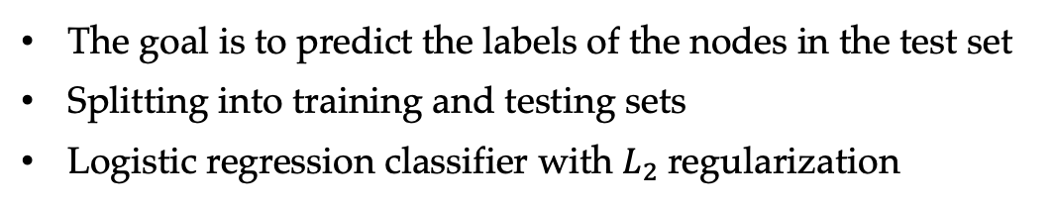
Experimental setup for node classification
The goal is to predict the labels of the nodes in the test set
Splitting into training and testing sets
Logistic regression classifier with $L_{2}$regularization
Notes:
- For the node classification task, nodes have labels.
Our goal is to predict the labels of the nodes in the test set.
After learning the embeddings, we split the set into various training and testing sets.
The we run logistic regression with l2 regularization to predict the node labels.

Slide 28
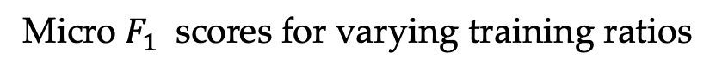
Experiments: Node classification
Micro $F_{1}$ scores for varying training ratios
Notes:
We show only Micro F1 scores for 10, 50 and 90% training ratios.
Because of space and time constraints, here we report a subset of the results for the citeseer and dblp network
As we have seen before, the-glda and tne-ghmm models uses random walks to find community assignments and they shod comparable performances.
We observe that on these networks, the network structure based models are better at decting the latent comunities and so they obtain higher accuracy in the experiments.

Slide 29
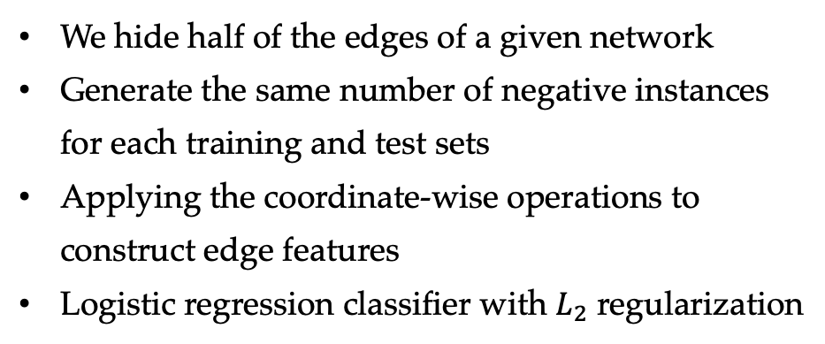
Experimental setup for link prediction
We hide half of the edges of a given network
Generate the same number of negative instances for each training and test sets
Applying the coordinate-wise operations to construct edge features
Logistic regression classifier with $L_{2}$ regularization
Binary operators
Notes:
For the link prediction task,
We hide the half of edges of a give network and the removed edges contruct the positive samples for testing set.
We sample the same number of node pair which do not exist in the given network, and they construct the negative samples.
We apply the operators shown in the table to construct the edge features
For each model, we use the operator giving the highest score.

Slide 30
Experiments: Link prediction
Area Under Curve (AUC) scores for the link prediction task
Notes:
We report the AUC scores.
TNE-Ghmm model shows better performance than the others
- TNE-Louvain and TNE-BigClam also demonstrate very close and comparable achievements to TNE-Ghmm.
- Since we consider node order in learning community representations, tne-Ghmm is better at capturing network structure.

Slide 31
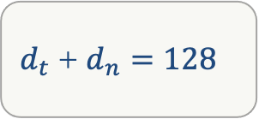
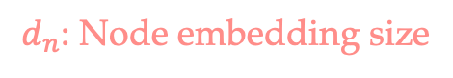
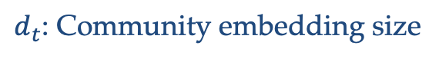
Experiments: Influence of the community embedding size for TNE-Louvain
$d_{t}$ + $d_{n}=128$
$d_{t}$: Community embedding size
$d_{n}$: Node embedding size
Notes:
- We have also performed parameter sensitiviy analysis.
- Here, we study the influence of the embedding size for Tne-Louvain instance on the citeseer network for the classification.
We set the node representation size as 128 in our all experiments so the sum node and embedding sizes should be 128.
As you can see, when we increase community embedding size, the accuracy of the approach increase up to the community embedding size 48. Then we observe a drop in the performance after this value because we also lose the information preserved in the node embeddings.
We presented more sensitivity analysis experiment in the thesis.

Slide 32
Conclusion
TNE: A topic-aware family of models for GRL
TNE-GLda, TNE-GHmm, TNE-Louvain, TNE-BigClam
Community representations with the instances either relying on random walks or well-known community detection algorithms
Enriched representations, which lead to competitive performance in
Node classification
Link prediction
Notes:
- We have proposed TNE, a topic-aware family of models for GRL and studied its four instances.
- We learn community representations by either using random walks to infer the community labels or using the community detection algorithms.
- The experimental evaluation shows that TNE shows competitive performance with enriched representations in node classification and link prediction.

Slide 33
3. EFGE: Exponential Family Graph Embeddings
Notes:
In next approach, we will see how can we model and capture the underlying pattern of node pairs properly within random walks sequences.

Slide 34
Motivation
The objective function of random walk-based representation learning models is
Context set of node
: Number of walks
: Walk length
: Set of walks
: Community/topic
embeddings
Modeling choice for node pairs within the walks
Notes:
As we have seen in the previous parts, the RW-based approaches define the objective function as follows
The context set C_gamma indicates the context set of node w_l
- RW-based graph representation learning methods can use different approaches to sample the context set. While Deepwalk uses uniform random walk strategy, Node2vec applies biased walk
But they similarly model the node interactions by either choosing sigmoid or softmax function.
- Using softmax or sigmoid has some limitations in the modeling the interaction between the nodes. As we will present in the following part, we rely on exponential family distributions to further extend and generalize random-walk GRL models to capture richer types of node interaction patterns.

Slide 35
Exponential family distributions
We capitalize on exponential family distributions
Base measure
Log-partition function
Natural parameter
Sufficient statistic
where is the link function
Bernoulli, Poisson, Normal distributions
Notes:
The exponential family is a set of probability distr. satisfying certain form.
We define the eta as the function of embeddings.
Many common probability distributions such Bernoulli, poisson or normal distribution can be written in the exponential form.

Slide 36
EFGE: Exponential Family Graph Embeddings
The interaction between nodes and
Regularization term
The objective function can be rewritten as follows:
Notes:
We define a similar objective function to the other random walk based GRL models
But here, we adopt a quadratic regularization term and we maximize log-likelihood function not only for context nodes, we also maximize it for the non-context ones.
The random variable Y indicates the relationship between nodes w_l and v.
After plugging the exponential form into the objective function, we can write the objective as follow
||
The model has a flexibility to utilize a wide range of exponential distributions, which allows it to capture more complex types of node interactions beyond simple co-occurrence relationships.

Slide 37
EFGE-Bern model
EFGE-Bern model
indicates if node appears in the context of center node
The objective function is
For large values of , the log-likelihood function can be approximated by
Notes:
In the first approach, we adopt the Bernoulli distribution and we model if a node appears in the context or not.
Here, for example node v_4 belongs to the context set of v_5 but v_2 does not.
We can split the objective function of the approach w.r.t the values of Y as the nodes belong to the context set and the ones don’t
We show that the log likelihood function of the EFGE-Bern model in fact can approximated by the negative sampling.
So instead of summing over all non-context nodes, we can approximate the objective by sampling k negative insatcnes.

Slide 38
EFGE-Pois model
EFGE-Pois model
indicates the number of occurrences of node appears in the context of node
Fast approximation to objective via negative sampling
Relationship to the overlapping community detection BigClam
Notes:
In the next approach we examine Poisson distirubtion.
we models how many times a node appears in the context.
Here, for example node v_6 two times in the context of node v_5.
We show that we can approximate the objective function the negative sampling strategy
We show that the objective function similar to BigClam can be obtained by unifying the objectives of the EFGE-Bern and EFGE-Pois models. In that case we can see the each entry of the node embedding vector can be considered as a coefficient indicating the node’s membership strength to the corresponding community

Slide 39
EFGE-Norm model
EFGE-Norm model
indicates the interaction weight between node and the context node
The link function
Notes:
In the last approach, we adopt normal distirubiton
We assume that Y is normally distributed with mean 1 if the node y belongs to the context set otherwise distributed with mean 0.
We assume that the random variables indicate the interaction weight between node v and the context node $w_{l}$
We choose a link function different from the identity map.
Now, these are our three instances of the model and we will examine their performance in the node classification and link prediction experiments in the next part.

Slide 40
Experiments: Node classification
Micro $F_{1}$ scores for varying training ratios
Notes:
As you can poisson model shows quite good performance. Since it models the number of occurrences of a node in the context, it is better at capturing the node label information.

Slide 41
Experiments: Link prediction
Area Under Curve (AUC) scores for the link prediction task
Notes:
The performances of EFGE variants are distinctive for the networks such as DBLP, AstroPh, HepTh and Facebook
Since we use the walks produced by Node2Vec, the performance of the EFGE instances highly affected by these generated walks; this can be especially seen over Gnutella network.

Slide 42
Conclusion
The model generalizes random walk approaches to exponential families
EFGE-Bern, EFGE-Pois and EFGE-Norm instances
The connection between the EFGE-Bern model and the negative sampling
Interpretation of the objective function of BigClam under the variants of the EFGE model
The proposed models generally outperform the baseline approaches in various tasks
Notes:
To conclude this part, we introduce a novel representation learning model, called EFGE, which generalizes classical random walk-based approaches to exponential family distributions, towards more expressive GRL. We study EFGE-Bern, EFGE-Pois, and EFGE-Norm variants.
We have shown the connection between the objective function of EFGE-Bern model and the negative sampling strategy.
- We have shown that the objective function of an overlapping community detection BigClam can be re-interpreted under the variants of EFGE model.
- We demonstrate that the proposed exponential family graph embedding models generally outperform
widely used baseline approaches in various learning tasks

Slide 43
4. Multiple Kernel Representation Learning on Graphs
Notes:
in the 4rd part of the thesis we aim at studying how can we augment the predictive capacity of random walk-based matrix factorization methods with kernel functions.

Slide 44
Motivation
How can kernel functions be used to enhance the node embeddings?
Combination of matrix factorization and random walks in a kernelized model for learning node embeddings
Extension of the kernelized weighted matrix factorization framework with a linear combination of a predefined set of kernels
Notes:
We will examine how kernel functions can be used to further enhance node embeddings
- We aim to combine matrix factorization and random walks in a kernelized model for learning node embedding.
Furthermore, we introduce a multiple kernel learning formulation of the model, which extends the framework by learning a linear combination of a predefined set of kernels.

Slide 45
Weighted matrix factorization
The objective function is defined as a weighted matrix factorization as follows:
Weight matrix
Target matrix
Embedding matrices
d: Embedding dimension
: Hadamard product
Notes:
More formally, we define the general objective function of our problem as a weighted matrix factorization
- Each element W(v,u) of the weight matrix W captures the importance of the approximation error between nodes v and u

Slide 46
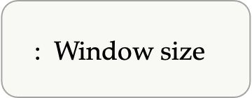
Kernel representation learning on graphs (1/2)
We generate a set of fixed length walks
Let be where is the number of occurrences of in the walks
By setting each term as the square root of
: Window size
Notes:
We generate a set of fixed length walks
We define the matrix F as the number of occurrences of node times the window size
By setting each term of W as the square root of F, we can re-express the objective function with random walks
So we don’t need the exact realization of the target matrix M, we can learn the embeddings A,B without it.
||
- Our motivation is to move the inner product from the input space to possibly higher dimensional space by reformulating the equation to obtain more expressive/discriminative embeddings.

Slide 47
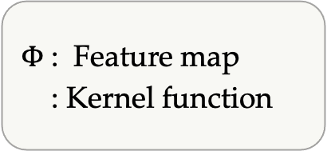
Kernel representation learning on graphs (2/2)
Integration of kernels
Feature maps
$Φ$: Feature map
: Kernel function
Kernel function
Notes:
We incorparate the kernels with the objective function. Here, phi indicates the feature map of the corresponding kernel.
- Our formulation is completely different from the existing approaches using kernels. Kernel methods or tricks are generally used to map the non-linearly separable data points to a higher-dimensional space. Conversely, here, we perform the optimization in the feature space, and use the preimage of the feature maps as the embeddings.

Slide 48
KernelNE: Kernel node embeddings
We apply negative sampling strategy
Number of negative samples
The objective function is
Single kernel version: KernelNE
Notes:
Since we sum over all nodes in the graph, the objective function can be divided into two parts as context and non-context nodes.
Then, we can apply negative sampling strategy as we did in EFGE model, which provides an advantage for us in the optimization step of the algorithm.
We can apply negative sampling strategy so Instead of summing all non-context nodes, we can only sample k negative samples in learning the emebddings.
In brief, the approach combines random walks and kernels in a MF framework, and we call it as KernelNE.

Slide 49
MKernelNE: Multiple kernel node embeddings
Integration of multiple kernels
Number of kernels
The objective function for multiple kernel representation learning is
Coefficients of kernels
Trade-off parameter for the regularization term
Multiple kernel version: MKernelNE
Notes:
Choosing a single kernel function might impose potential bias, and cause limitations on the performance of the model.
- So we might utilize multiple kernels to increase the expressiveness of the model, to capture different notions of similarity.
- We use the same obj function and we just integrate with the linear combination of multiple kernels.
The coefficients c represent the contribution of the corresponding kernel
We call MKernelNE

Slide 50
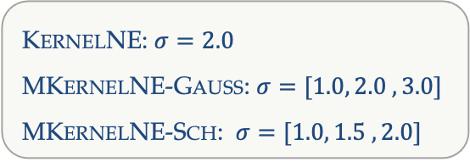
Experiments: Visualization of node embeddings of Dolphins in the 2D space
KernelNE: $σ=2.0$
MKernelNE-Gauss: $σ=[1.0, 2.0 ,3.0]$
MKernelNE-Sch: $σ=[1.0, 1.5 ,2.0]$
Notes:
For an illustrative purposes, we have done visualization experiment on dolphins netwrok.
We use the Louvain, which is modularity-maximization algorithm, to detect the communities in the network, each color indicates a community found by Louvain
We adopt two universal universal kernel, gaussian and schoenberg
-
- As you can see, the multi-kernel version of the model, nodes of the same community are better distributed in the two-dimensional space.

Slide 51
Experiments: Classification
Micro $F_{1}$ scores for varying training ratios
Notes:
Here, we perform the classification experiment and report Micro F1 for DBLP and PPI networks.
-Single version shows comparable results
Especially, the multi gaussian kernel version of the model perform better than the single version and it shows the advantage of adapting multi-kernel

Slide 52
Experiments: Link prediction
Area Under Curve (AUC) scores for the link prediction task
Notes:
- For the link prediction task.
- In the case of the single kernel model KernelNE, the Schoenberg kernel performs significantly better than the Gaussian one.
We observe that MKernelNE provides a performance gain.
- The impact of adopting multiple kernels for the Gaussian case is more visible than the Schoenberg kernel.

Slide 53
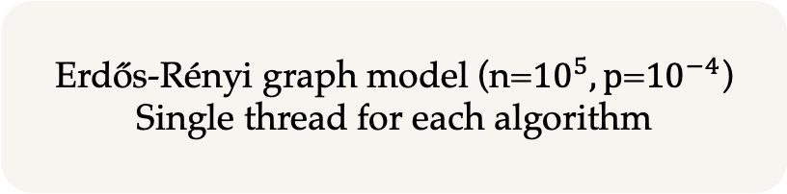
Experiments: Comparison of running times on Erdős–Rényi graphs
Erdős-Rényi graph model (n=${10}^{5}, p$=${10}^{−4}$)
Single thread for each algorithm
Notes:
-We also performed a running time comparison for the baseline approaches. Here, kernelne runs faster than other ML-based approaches such netmf and m-nmf and it shows comparable performance to the methods such node2vec and line.

Slide 54
Conclusion
KernelNE: Kernelized matrix factorization with random walks
Universal kernels: Gaussian and Schoenberg
Efficient approximation to the objective function
MKernelNE: The multiple kernel learning framework
Notes:
We have first introduced KernelNE, a model that aims at interpreting random-walk based node proximity under a weighted matrix factorization framework, allowing to utilize kernel functions.
We have adapted universal kernels and examined two variants: gaussian and Schoenberg kernels
To further boost performance, we have introduced MKernelNE, extending the proposed methodology to the multiple kernel learning framework.
- Extensive experimental evaluation showed that the proposed kernelized models substantially outperform baseline GRL methods in node classification and link prediction tasks.

Slide 55
The proposed learning-based models
TNE
TNE-Glda, TNE-Ghmm, TNE-Louvain, TNE-BigCLam
EFGE
EFGE-Bern, EFGE-Pois, EFGE-Norm
KernelNE, MKernelNE
Notes:
- Up to now, we have seen three learnable graph representation models. Now, our next approach will be different than these ones.
We have also provided a detailed empirical comparison of the models in the thesis.

Slide 56
5. Random Walk Diffusion Meets Hashing for Scalable Graph Embeddings
Notes:
- We now target large-scale networks and we need to learn representations fast but the performance on the downstream task shouldn't be low. Therefore, our goal is to design an algorithm balancing the efficiency and the performance.

Slide 57
Motivation
Input Network
Node Representations
Locality Sensitive Hashing (LSH)
Hash Codes
Represent nodes having similar characteristics with similar representations
Mapping similar input items to the same hash code with higher probability than dissimilar ones
Smaller storage requirements
Binary, integer, real-valued
Fast computation of hash codes
Large-scale networks
Studied in other areas
Computer vision
NLP
Statistics
Fast similarity computation
Notes:
- As we have discussed in the introduction part, our goal is to map nodes having similar characteristics to close representations.
- In this case, we target large scale networks
LSH is one of the popular solutions for approximate nearest neighbor search.
It aims to map similar input items to the same hash code with higher probability than dissimilar ones.
It is a widely used approach such as NLP, Statistics, Computer Vision and used for the tasks such image classification, image matching.
They generate hash codes which might be binary or integer valued.
They learn the hash codes fast and they allow to fast similarity computation for a pair of hash codes.

Slide 58
NodeSig: Warm-up
Input network
Design of feature vectors corresponding to nodes
Choosing an appropriate hashing technique
Learning binary embeddings
[1, 0, 1, 1, 1, 0, 0, 0, 1]
[1, 0, 1, 1, 1, 0, 0, 0, 1]
Notes:
-Our main motivation comes from the hashing techniques and we would like to design an algorithm for large scale networks
- If we are given such a network. Then, we will design features corresponding to the nodes and we need to choose an hashing function suitable to our features. Finally, we learn binary embeddings.

Slide 59
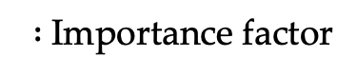
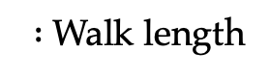
Designing node feature vectors
$:$Walk length
$:$Importance factor
Notes:
For the node features or the target matrix, we use the sum of the powers of the transition matrix.
-We might also extend these features by introducing additional parameter alpha.
- For example, we can put more emphasize on the nodes appearing in the larger steps for by setting alpha greater than 1.

Slide 60
Designing node feature vectors
$:$Walk length
$:$Importance factor
Notes:
- The approach is again related to the random walks but here, we don’t generate the random walks exactly.
- For alpha equal to 1, the entries of M mainly indicate the expected number of seeing a node within a walk of length L

Slide 61
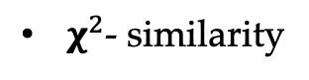
Choosing a hash function
$χ^{2}$- similarity
Notes:
The node features have positive weights.
The node features that we have designed are the histogram-type data.
- The chi-square distance is one of the common choices to compare this data so it is very suitable to our designed features.
- But we will look for a hashing technique preserving the chi square distance.

Slide 62
Sign stable random projections
Hash function
For a given pair of vectors , and for
$α$-stable random projections
[Li et al. NIPS ’13]
Notes:
We define the hash function as the sign of the random projection.
We project a vector on the hyperplane and use the sign of the output values.
If project a pair of vectors on a hyperplane whose weights sampled from normal distribution, and then take their signs, the probability of obtaining different values is proportional to the angular distance between the vectors. But the angular distance is not suitable to our designed feature vectors.
If we sample the weights from alpha-stable distribution, we can derive an upper bound for the probability of obtaining different values.
For example, for sigma value equal to 2, it corresponds to the normal distribution and we have the equality above.
For alpha=1, we sample the weights from Cauchy distribution and it provides us a motivation for designing our hash technique.

Slide 63
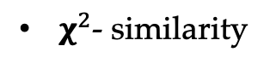
Binary representations
Approximation to $χ^{2}$- similarity by Hamming distance
[Li et al. NIPS ‘13]
Learning binary node representations
$χ^{2}$- similarity
[0, 1, 0, 0, 0, 1, 1, 0, 0, 1, 1, 0, 1, 1, 0, 1, 1]
Notes:
-. It has been experimentally showed that we can approximate the chi similarity by sampling the weights of projection matrix from Cauchy distriubitons.
For our approach, we adopt the sign Cauchy random projection.
-. After the projection of the designed feature vectors, we take the sign of the signs of the values.and get the embeddings
-We can approximate the chi similarity between the features by using the hamming distance in the embedding space.

Slide 64
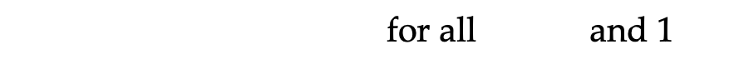
Overview of the NodeSig model
: Vertex set
: Embedding size
for all and 1
Notes:
A general overview of the approach is as follows:
- We are a given a network,
- We sample weights from cauchy distributions.

Slide 65
Overview of the NodeSig model
Recursive computation
Notes:
- Then we need to compute the feature matirx and project it. But our formulation allows us to compute this projection in a recursive way by propogating the weights without exact feature matrix.

Slide 66
Overview of the NodeSig model
Notes:
- Finally, we use the signs of the projectins to obtain our final embeddings.

Slide 67
NodeSig: Experiments
One-vs-rest SVM classifier with a pre-computed kernel
For the kernel matrix, Cosine or Hamming distance is applied
[Yang et al. KDD ’19]
Two new datasets
HOPE
Node2Vec
NetSMF
LouvainNE
RandNE
NodeSketch
[Ou et al. KDD ‘16]
[Grover et al. KDD ‘16]
[Qui et al. WWW ‘19]
[Bhowmick et al. WSDM ‘20]
[Zhang et al. ICDM ‘18]
[Yang et al. KDD ’19]
Notes:
- For the experimental setup, we follow a different strategy proposed by the paper of Yang since we have binary embeddings.
For the computation of the kernel matrix, we use cosine similarity for the real-valued embeddings or hamming distance depending the type of embedding vector
- We add two large networks
- We add scalable baseline methods such as netsmf and LouvainNE and hashing based algorithms such nodesketch and randne

Slide 68
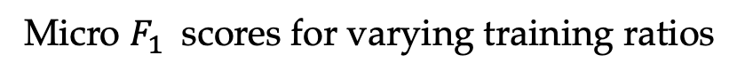
Experiments: Classification
Micro $F_{1}$ scores for varying training ratios
Notes:
+ Again, we report Micro F_1 results for Blogcatlog, PPI and Youtube network
+ As you see NodeSig outperforms the baselined in most cases.
+ Nodesketch and NetSMF also behave very well too. And Nodesig shows comparable performance to them.

Slide 69
Experiments: Link prediction
Area Under Curve (AUC) scores for the link prediction task
Notes:
For link prediction taks, we have also cora and dblp networks.
Nodesig outperforms the baselines on Blogcatalog dblp and youtube networks.
NetSmf shows good accuracy on youtube dataset and nodesig shows very close performance to it on youtube.

Slide 70
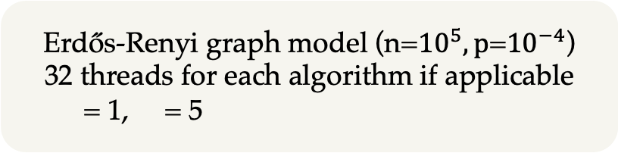
Experiments: Running time and average speedup comparison
Running time (in seconds) and average speedup
DBLP
Erdős-Renyi graph model (n=${10}^{5}, p$=${10}^{−4}$)
32 threads for each algorithm if applicable
= 1, = 5
Notes:
- Here, we also compare the running time and average speed-up of the algorithm. The time is given in seconds.
- Random network indicates the graph generated erdos renyi model.
As you can see our approach runs faster than the classical graph representation learning approaches.
It is slower than some scalable algorithms but it shows better performance in many cases.
In the figure on the right side, the x-axis shows the running time and y-axis indicate the Micro F_1 score for DBLP network. As you can see, nodesig balances the accuracy and running and the running time

Slide 71
Conclusion
NodeSig: An efficient binary node embedding model
It exploits random walk diffusion probabilities via stable random projection hashing
Approximation to Chi similarity
It balances between good accuracy and low running time
Notes:
We have introduced NodeSig, an efficient binary node embedding model.
NodeSig exploits random walk diffusion probabilities via stable random projection hashing, towards efficiently computing the representations in the Hamming space.
We can approximate the chi similarity of the designed feature vectors by the hamming distance.
We demonstrate that the proposed binary embeddings achieve superior performance compared to various baseline models on two downstream tasks.
- At the same time, the running time required to compute node signatures allows the model to scale on large graphs.

Slide 72
Conclusion

Slide 73
Conclusion
Community information
Statistical models and community detection algorithms
Enriched representations
TNE
EFGE
Exponential family
Negative sampling
Overlapping community detection method
Random Walk Diffusions
Kernels + matrix factorization
Two universal kernels
Multiple kernel framework
KernelNE
NodeSig
Binary representations
Chi similarity
Accuracy vs. running time
Notes:
To summarize the contributions of the thesis
We have proposed four different approaches based on random walks.
TNE
We have proposed four different approaches based on random walks.
Firstly, we have seen TNE model, which leverages community information.
We learn community embeddings by applying statistical and community detection algorithms.
The exper. evaluation shows that TNE model outperforms the baselines in most of the cases.
Firstly, we aim to explicitly integrate the community information in the representation learning process so we proposed a novel framework, TNE, which explicitly incorporates the underlying community
TNE extracts the latent node community assignments with various community detection methods and statistical models relying on random walks.
The experimental evaluation has showed that the integration of community information in learning embeddings enhances the node representations’ performance in downstream tasks.
EFGE
- The existing random walk-based models rely on the SkipGram model so it causes limitations concerning the expressiveness of the model. To address this point, we introduced EFGE model which leverages exponential family distriubtions.
We have employed three instances of exponential family distributions to represent the interactions among nodes and learn their representations
The connection between the model and the negative sampling strategy
The objective function of BigClam can be re-interpreted under the EFGE model
Expressive node embeddings
The experimental evaluation has demonstrated the benefit of exponential family distributions on the performance of downstream tasks.
KernelNE
We have first introduced KernelNE, a model that aims at interpreting random-walk based node proximity under a weighted matrix factorization framework, allowing to utilize kernel functions.
We have adapted universal kernels and examined two variants: gaussian and Schoenberg kernels
To further boost performance, we have introduced MKernelNE, extending the proposed methodology to the multiple kernel learning framework.
Extensive experimental evaluation showed that the proposed kernelized models substantially outperform baseline GRL methods in node classification and link prediction tasks.
NodeSig
We have introduced NodeSig, an efficient binary node embedding model which efficiently computing the representations in the Hamming space.
We can approximate the chi similarity of the designed feature vectors by the hamming distance.
NodeSig outperformed in accuracy recent highly scalable models, being able to run within reasonable time duration, while at the same time it shows comparable or even better accuracy w.r.t to widely used baseline methods in node classification and link prediction

Slide 74
Future work
Scalable node representation learning methods
Locality sensitive hashing (LSH)
Learning to hash techniques (e.g., kernel functions with data vectors)
Graph representation learning (GRL) methods for dynamic networks
The embedding vectors should be updated concerning the modifications
The random walk-based approaches might be adapted
Updates of random walks only for the affected part of the network
Graph Neural Networks (GNNs)
Random walks
Binary Graph Neural Networks
Notes:
For the further research, a possible direction might be the algorithms for large-scale networks.
“As we discussed in the last part of this presentation”, LSH techniques promise a quite good direction but their performance is not always good.
That's why learning-to-hash techniques might be a solution deal with these problems. They mainly aim to learn hash function for a given dataset by minimizing the discrepancy between the similarities in the original space and the embedding space.
- So we can for example incorporate kernel functions with the data vectors of nodes in order to learn the projection matrix
First research direction might be the dynamic networks.
+ Dynamic networks
Many real-world networks undergo changes over time so the embedding vectors should be updated concerning the modifications occurring in the network
- For instance, ..
- Another direction might be GNNs. They are very powerful methods but they require high compututional cost especially for large scale networks.
- For example, GCNs agggrate information from a local neighboods. Some methods use higher order k-hop neighbors or some might have many connections than the other so they sampling methods so the complexity of the algorithm increase.
- Here, we can adopt random walks for sampling and chosing the local neighbords
-BNN have been also used in other such as computer vision. They learn binary representation and binarize weights of layers to alleviate the computional and space constraints. So we can adopt this type of approaches for GNN.

Slide 75
Thank you!

Slide 76
List of publications
[ÇM18] Abdulkadir Çelikkanat and Fragkiskos D. Malliaros. TNE: A Latent Model for Representation Learning on Networks. In NeurIPS Relational Representation Learning (NeurIPS-R2L) Workshop, 2018.
[ÇM21] Abdulkadir Çelikkanat and Fragkiskos D. Malliaros. Topic Aware Latent Models for Representation Learning on Networks. Pattern Recognition Letters 144 (2021), pp. 89–96.
[ÇM19b] Abdulkadir Çelikkanat and Fragkiskos D. Malliaros. Learning Node Embeddings with Exponential Family Distributions. In NeurIPS Graph Representation Learning Workshop (NeurIPS-GRL) Workshop, 2019.
[ÇM20] Abdulkadir Çelikkanat and Fragkiskos D. Malliaros. Exponential Family Graph Embeddings. In AAAI, 2020, pp. 3357–3364.

Slide 77
List of publications
[ÇM19a] Abdulkadir Çelikkanat and Fragkiskos D. Malliaros. Kernel Node Embeddings. In GlobalSIP, 2019, pp. 1–5.
[ÇSM21] Abdulkadir Çelikkanat, Yanning Shen, and Fragkiskos D. Malliaros. Multiple Kernel Representation Learning on Networks. Manuscript (2021)
[ÇPM21] Abdulkadir Çelikkanat, Apostolos N. Papadopoulos, and Fragkiskos D. Malliaros. NodeSig: Random Walk Diffusion meets Hashing for Scalable Graph Embeddings. Manuscript (2021).

Slide 78
References

Slide 79
References
[Perozzi et al. KDD ‘14] Bryan Perozzi, Rami Al-Rfou, and Steven Skiena. DeepWalk: Online Learning of Social Representations. In KDD, 2014, pp. 701– 710
[Grover et al. KDD ‘16] Aditya Grover and Jure Leskovec. Node2Vec: Scalable Feature Learning for Networks. In KDD, 2016, pp. 855–864
[Qiu et al. WSDM ‘18] Jiezhong Qiu et al. Network Embedding As Matrix Factorization: Unifying DeepWalk, LINE, PTE, and Node2Vec. In WSDM, 2018, pp. 459–467
[Ou et al. KDD ‘16] Mingdong Ou, Peng Cui, Jian Pei, Ziwei Zhang, and Wenwu Zhu. Asymmetric Transitivity Preserving Graph Embedding. In KDD, 2016, pp. 1105–1114
[Tang et al. WWW ‘15] Jian Tang, Meng Qu, Mingzhe Wang, Ming Zhang, Jun Yan, and Qiaozhu Mei. LINE: Large-scale Information Network Embedding. In WWW, 2015
[Rozemberczki et al. ASONAM ‘19] Benedek Rozemberczki, Ryan Davies, Rik Sarkar, and Charles Sutton. GEMSEC: Graph Embedding with Self Clustering. In ASONAM, 2019
[Wang et al. AAAI ‘17] Xiao Wang, Peng Cui, Jing Wang, Jian Pei, Wenwu Zhu, and Shiqiang Yang. Community Preserving Network Embedding. In AAAI, 2017, pp. 203–209

Slide 80
References
[Yang et al. KDD ’19] Dingqi Yang et al. NodeSketch: Highly-Efficient Graph Embeddings via Recursive Sketching. In KDD, 2019.
[Qui et al. WWW ‘19] Jiezhong Qiu, Yuxiao Dong, Hao Ma, Jian Li, ChiWang, Kuansan Wang, and Jie Tang. NetSMF: Large-Scale Network Embedding as Sparse Matrix Factorization. In WWW, 2019
[Bhowmick et al. WSDM ‘20] Ayan Kumar Bhowmick, Koushik Meneni, Maximilien Danisch, Jean-Loup Guillaume, and Bivas Mitra. LouvainNE: Hierarchical Louvain Method for High Quality and Scalable Network Embedding. In WSDM, 2020, pp. 43–51
[Zhang et al. ICDM ‘18] Z. Zhang, P. Cui, H. Li, X. Wang, and W. Zhu. Billion-Scale Network Embedding with Iterative Random Projection. In ICDM, 2018, pp. 787–796
[Li et al. NIPS ’13] Ping Li et al. Sign Cauchy Projections and Chi-Square Kernel. In NIPS, 2013
[Hamilton ’20] William L. Hamilton. Graph Representation Learning. Morgan and Claypool Publishers, 2020
[Blondel et al. J. Stat. Mech. ‘08] Vincent D Blondel, Jean-Loup Guillaume, Renaud Lambiotte, and Etienne Lefebvre. Fast unfolding of communities in large networks. J. Stat. Mech. 2008:10 (2008)

Slide 81
References
[Yang et al. WSDM ‘13] Jaewon Yang and Jure Leskovec. Overlapping Community Detection at Scale: A Nonnegative Matrix Factorization Approach. In WSDM, 2013, pp. 587–596
[Steinwart ‘02] Ingo Steinwart. On the Influence of the Kernel on the Consistency of Support Vector Machines. J. Mach. Learn. Res. 2 (2002), pp. 67–93
[Rossi et al. AAAI ‘15] Ryan A. Rossi and Nesreen K. Ahmed. The Network Data Repository with Interactive Graph Analytics and Visualization. In AAAI, 2015

Slide 82
Appendix

Slide 83
TNE: Visualization on the Karate network

Slide 84
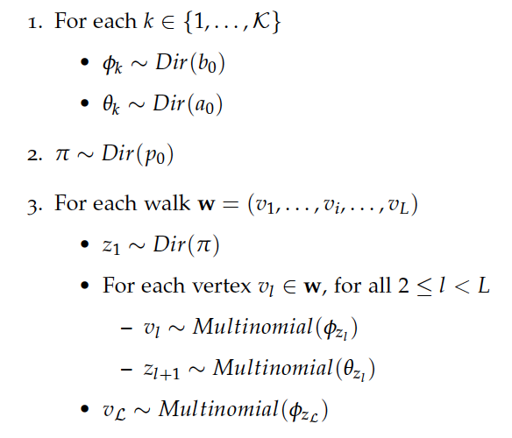
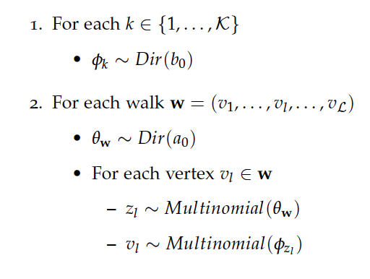
TNE: Glda and GHmm models
Glda Model
GHmm Model

Slide 85
TNE: Classification on the SBM network
Classification on the SBM with Micro-$F_{1}$ scores for 40% training ratio.
p = [0.06, 0.065, 0.07 ]
q = [0.04, 0.035, 0.003]
c = [1.25, 1.429, 1.667]
Link sampling in the Stochastic Block Model
Notes:
We use the Stochastic Block Model to construct graphs that consist of three clusters A, B and C, each one consists of thosound nodes.
The cluster structure of G3 is the most obvious one and G2 has clearer clustering structure.
The table provides the Micro-F1 scores for different walk lengths on the graphs with 40% of the datasets used as training set.
TNE-Louvain is the best performing instance. It detects good modularity communities from the graph structure itself, and thus, contrary to TNEGlda and TNE-Ghmm.
It does not rely on the the generated random walk sequences.

Slide 86
TNE: The influence of the number of topics for TNE-Glda on the Citeseer network

Slide 87
TNE: Running time analysis

Slide 88
EFGE: The influence of window size
Notes:
We study the influence of window size on Citesieer network

Slide 89
EFGE: The influence of the representation size on the Citeseer network
Notes:
We also performed various sensitivy for EFGE instances.
In this figure, we examined the influence of the representation size on Citeseer network for varying training ratios.
As you see, we have similar trends for all EFGE variants and we observe an increase in the classification performance of the models depending on the embdding size.

Slide 90
EFGE: The Influence of the standard deviation

Slide 91
KernelNE: Universal kernels
Gaussian and Schoenberg kernels
.
Approximate decomposition
Notes:
We use two universal kernels: gaussian, Schoenberg
A property of feature maps is that Every feature map of a universal kernel is injective so we can always find a unique element in the input space.
By proposition proposed by the paper of Ingo Steinward, we can find an approximate decomposition embedding matrices.

Slide 92
KernelNE: Influence of the dimension size on the Citeseer network.

Slide 93
KernelNE: Influence of kernel parameters
Notes:
- The kernel parameters have the parameters sigma, we examine the influence of them on the Citeseer network.

Slide 94
KernelNE: Running time analysis

Slide 95
Overview of the proposed learning-based models: Node classification
Comparison of methods for node classification with 10% training ratios.
Notes:
- We compare the approaches for 50% training ratios
- For each network, we report the score of the baseline method performing the best—so, the chosen baseline model might differ depending on the dataset.
-As you ican see the variants of the EFGE model is the best performing approach on Citeseer and DBLP and it is the second best for Cora and PPI

Slide 96
Overview of the proposed learning-based models: Node classification
Comparison of methods for node classification with 50% training ratios.
Notes:
- We compare the approaches for 50% training ratios
- For each network, we report the score of the baseline method performing the best—so, the chosen baseline model might differ depending on the dataset.
-As you ican see the variants of the EFGE model is the best performing approach on Citeseer and DBLP and it is the second best for Cora and PPI

Slide 97
Overview of the proposed learning-based models: Node classification
Comparison of methods for node classification with 90% training ratios.
Notes:
- We compare the approaches for 50% training ratios
- For each network, we report the score of the baseline method performing the best—so, the chosen baseline model might differ depending on the dataset.
-As you ican see the variants of the EFGE model is the best performing approach on Citeseer and DBLP and it is the second best for Cora and PPI

Slide 98
Overview of the proposed learning-based models: Link prediction
Area Under Curve (AUC) scores for the link prediction task.
Notes:
- For each network, we report the score of the baseline method performing the best—so, the chosen baseline model might differ depending on the dataset.
- the KernelNE-Sch and MKernelNE-Gauss variants show good performance—being the best performing models over the four networks.
-

Slide 99
NodeSig: Running time
HOPE
Node2Vec
NetSMF
LouvainNE
RandNE
NodeSketch
[Ou et al. KDD ‘16]
[Grover et al. KDD ‘16]
[Qui et al. WWW ‘19]
[Bhowmick et al. WSDM ‘20]
[Zhang et al. ICDM ‘18]
[Yang et al. KDD ’19]

Slide 100
NodeSig: Influence of the model parameters
Notes:
We examined the influence of model parameters on the cora network
For the walk length size, we observe increase in the performance of the algorithm especially for small training ratios.
For importance, we have good scores around 2 and in the experiments we set it to 1 for the simplicity.
For the dimension size, we have high scores for the dimension size around 2 to the power of thirteen.

Slide 101
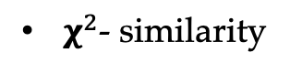
NodeSig: Experiments
Chi similarity: =
$χ^{2}$- similarity

